Slide 1

Intro to Solidity
- Jun Wei

Slide 2
Content
Basic Solidity Syntax
Deploy and interact with a simple contract using REMIX IDE.
Grasp state, functions, and visibility.

Slide 3
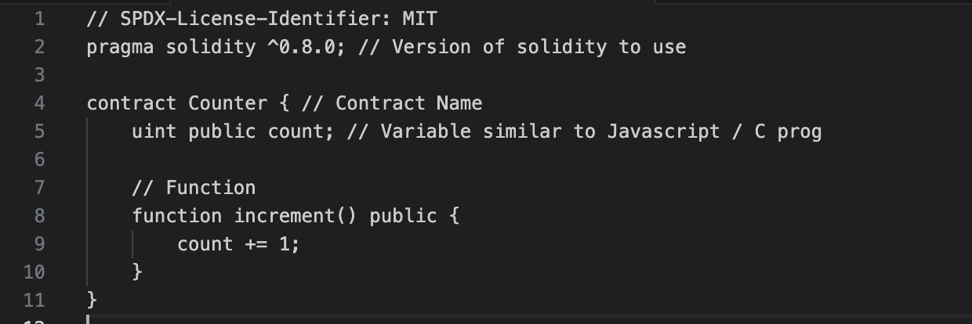
Basic Smart Contract

Slide 4
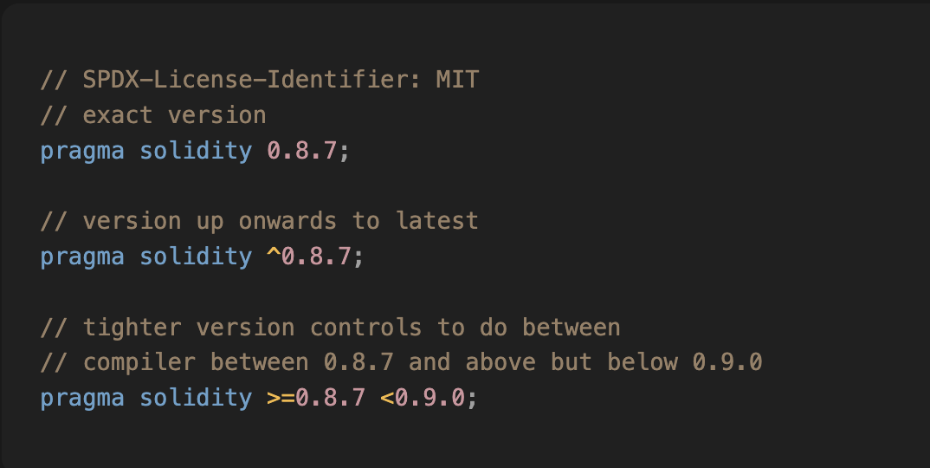
Version Control

Slide 5
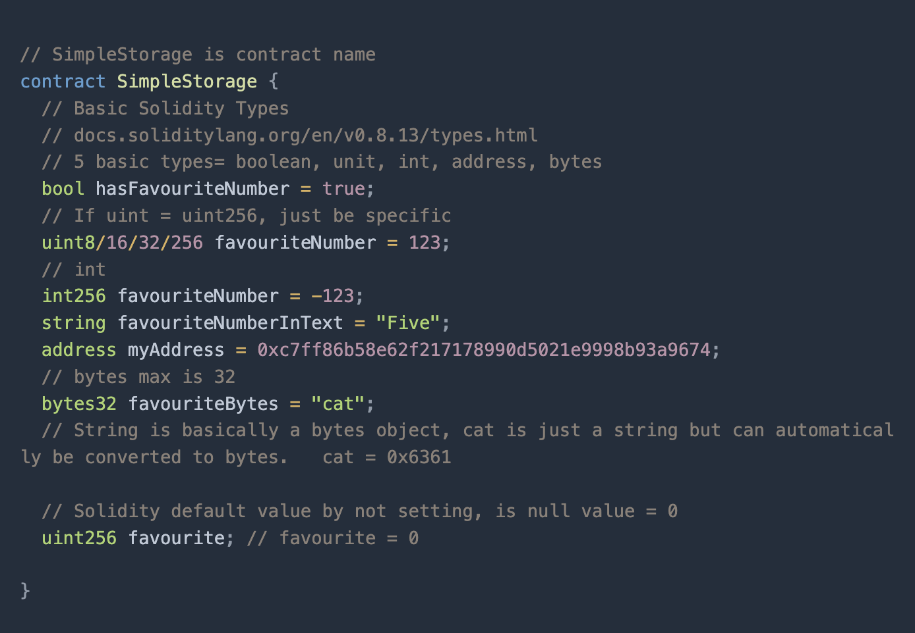
Variable Types

Slide 6
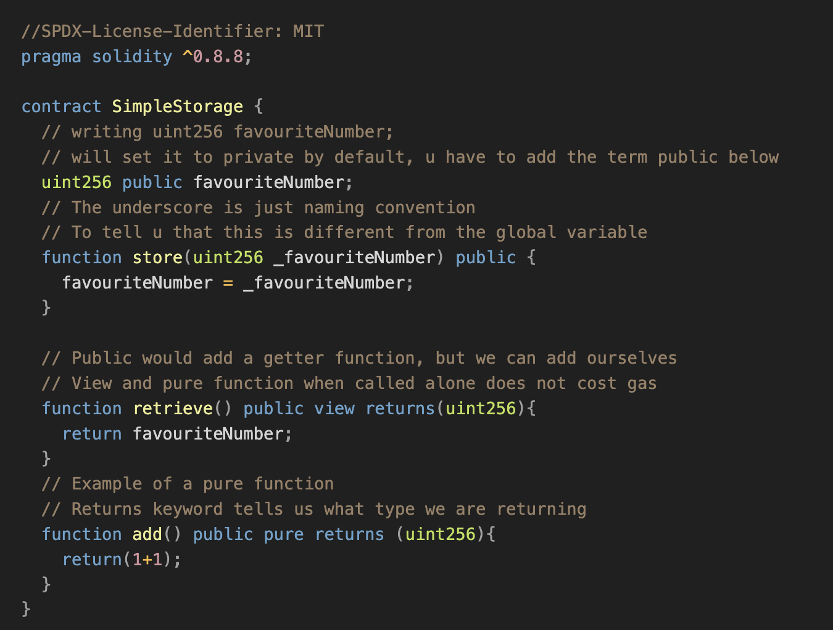
Basic Functions

Slide 7
Function Visibility
public : visible externally and internally (creates a getter function for storage/state variables)
private: Only visible in the current contract
external: only visible externally (only for functions) - e.g. can only be message-called (via this.func)
internal: only visible internally
View and pure functions, disallow modification of state
Pure functions additionally disallow you to read from blockchain state
If a gas calling function calls a view or pure function - only then will it cost gas

Slide 8
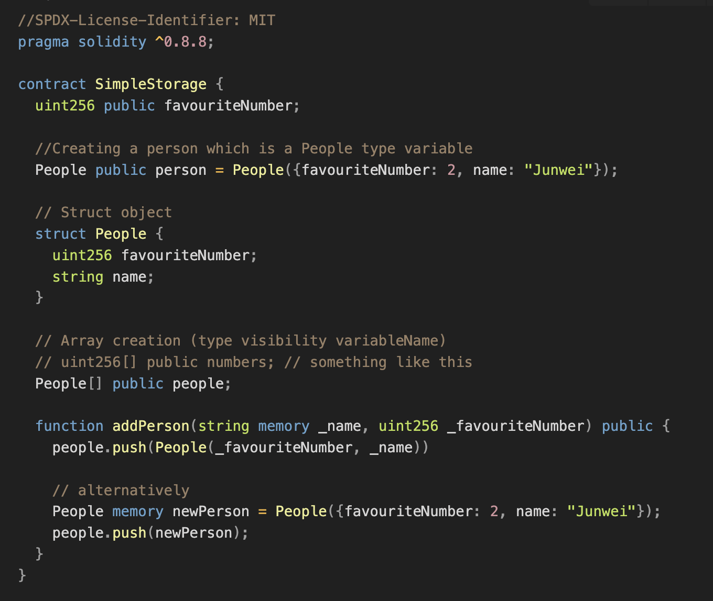
Array & Struct

Slide 9
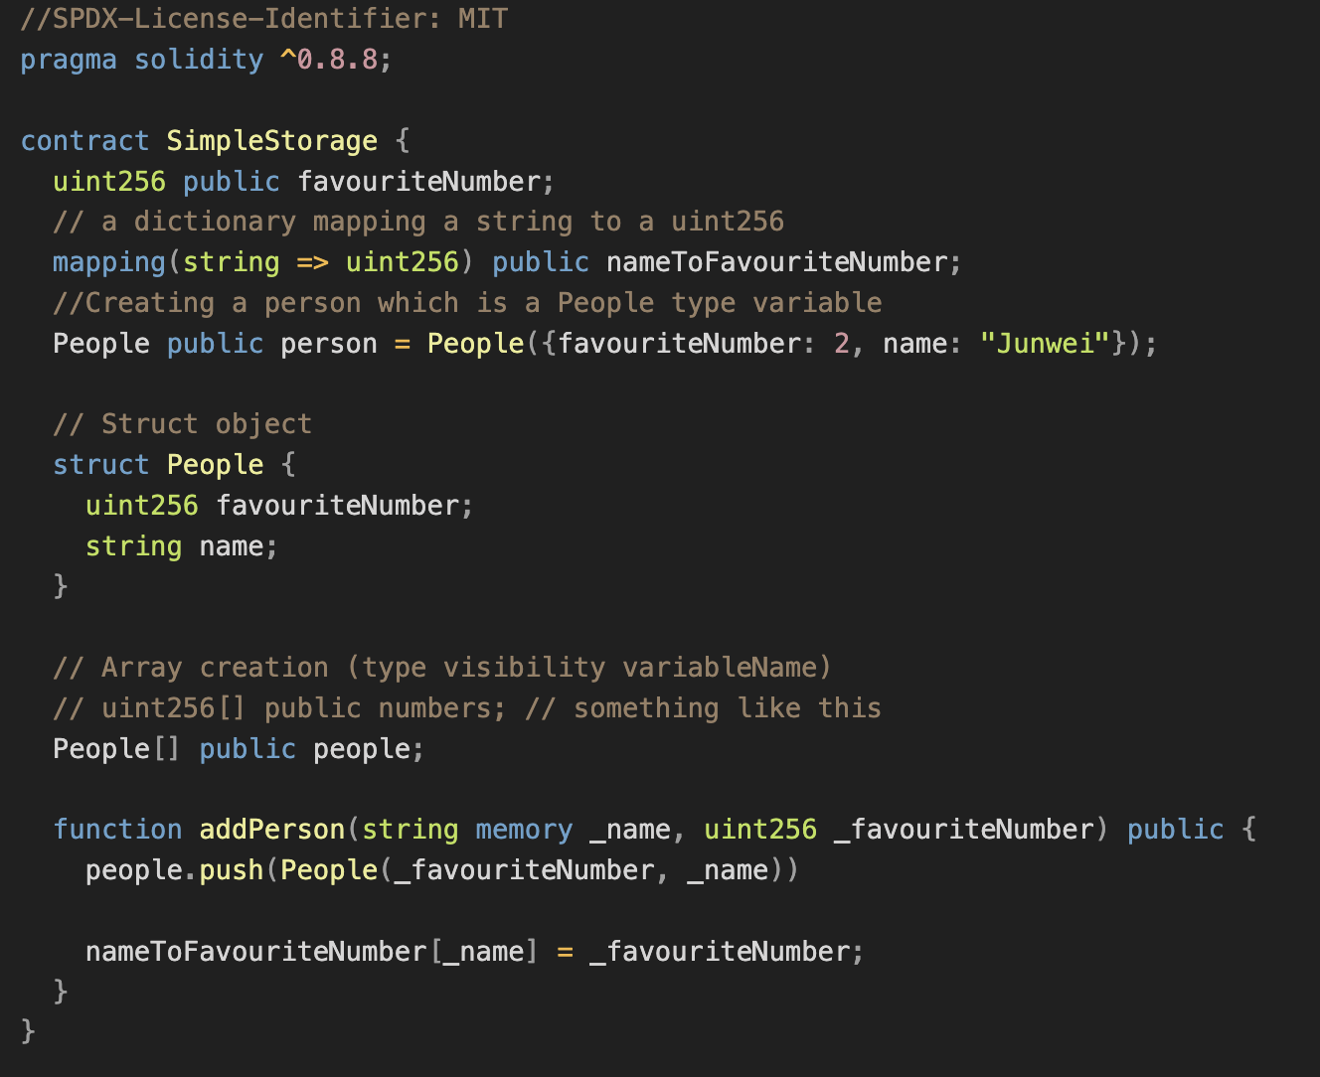
Mappings

Slide 10

REMIX IDE
https://remix.ethereum.org/

Slide 11
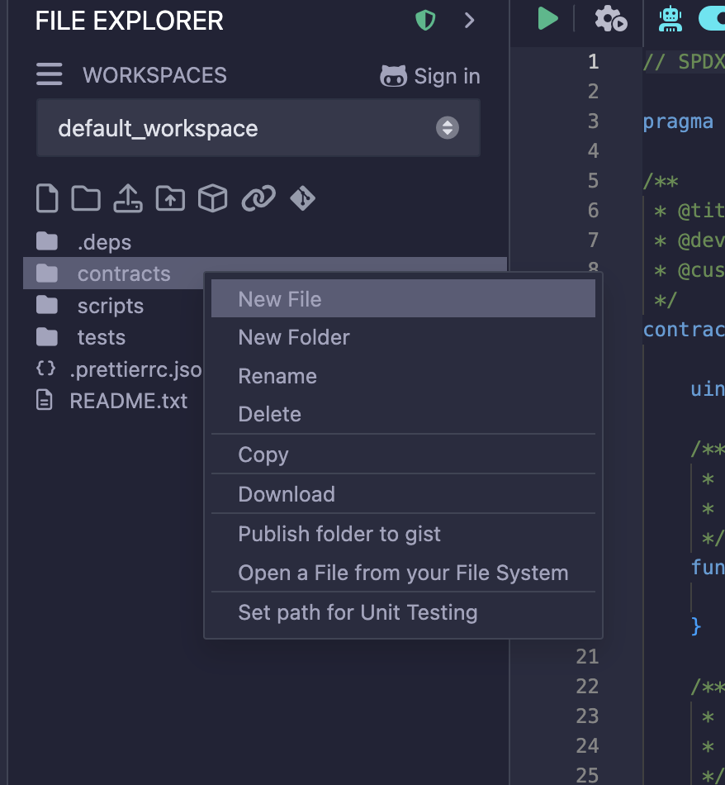
Getting Started

